Slide 1
Information Technology Infrastructure

Slide 2
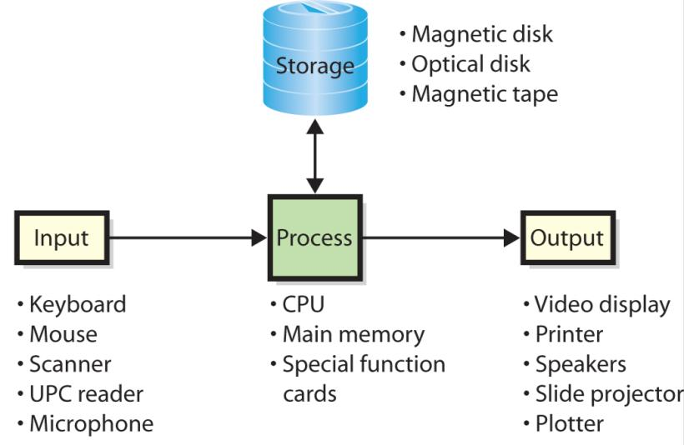
basic hardware categories
hardware consists of electronic components and related gadgetry that input, process, output, and store data according to instructions encoded in computer programs or software
Notes:
A computer with two CPUs is called a dual-processor computer. Quad-processor computers have four CPUs.

Slide 3
Computer Data
Computers represent data using binary digits, called bits.
A bit is either a 0 or a 1
Bits are grouped into 8-bit chunks called bytes.
Computer data, whether numbers, alphabetic characters or photos, are simple a string of bits.

Slide 4
Computer Data - Important Storage-Capacity Terminology
Term | Definition | Approximate # of Bytes
Byte (B) | Number of bits to represent one character
Kilobyte (KB) | 2¹⁰ bytes | 1 thousand
Megabyte (MB) | 2²⁰ or 1,048,576 bytes | 1 million
Gigabyte (GB) | 2³⁰ or 1,073,741,824 bytes | 1 billion
Terabyte (TB) | 2⁴⁰ or 1,099,511,627,776 bytes | 1 trillion
Petabyte (PB) | 2⁵⁰ bytes | 1 quadrillion
Exabyte (EB) | 2⁶⁰ bytes | 1 quintillion
Zettabyte (ZB) | 2⁷⁰ bytes | 1 sextillion
Yottabyte (YB) | 2⁸⁰ bytes | 1 septillion

Slide 5
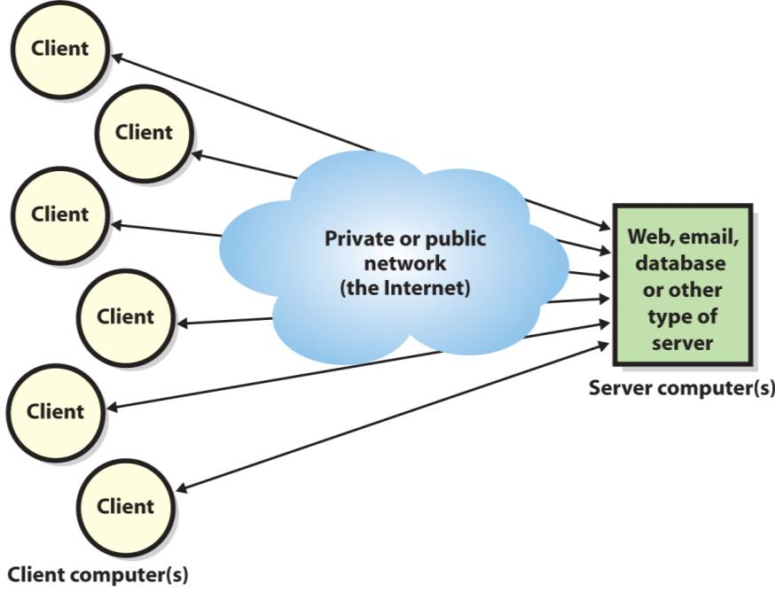
What Is the Difference Between a Client and a Server

Slide 6
Client and Server
Client computers
computers used by an individual for word processing, spreadsheets, database access, etc.
most client computers have software that enables them to connect to a private network at work or school, or to the public Internet.
Server computers
provide some service (such as email; serving pages on a website; processing large, shared databases; or other functions) to multiple users.

Slide 7
Client and Server
A typical server:
must be fast and have multiple CPUs
needs lots of main memory, at least 4GB
requires very large disks – often a terabyte or more
Because servers are almost always accessed from another computer via a network:
have limited video displays, or no display at all
many have no keyboard

Slide 8
Client and Server
Server farm
An organised collection of servers
Servers in a farm coordinate their activities in a sophisticated and fascinating technology dance.
Servers receive and process hundreds, possibly thousands, of service requests per minute:
in December 2005, Amazon.com processed an average of 41 order items per second for 24 hours straight.
Servers in a farm hand off partially processed requests to each other while keeping track of the current status of each request:
they can pick up the pieces when a computer in the farm fails
all of this is done in the blink of an eye.

Slide 9
Grid
Grid computing
A network of computers that operates as an integrated whole; the grid appears to be a single computer.
Grid may support a server farm, or some other computing need.
Organisations lease time on a grid from other organisations that create, support and manage that grid, e.g.
IBM leases time on a grid for applications that require intensive arithmetic computing
also leases time on a special-purpose grid to archive medical records.
Notes:
Grid computing is the collection of computer resources from multiple locations to reach a common goal.
Grid computing is distinguished from conventional high performance computing systems such as cluster computing in that grid computers have each node set to perform a different task/application.

Slide 10
Cloud computing
Cloud computing
Refers to a computing network on the Internet.
When you access a video from a site, such as Facebook, you are accessing computing services in the cloud:
you don’t know which server is processing your Facebook requests or which server is playing the video
you just know that somewhere in the cloud one or more servers is causing the video to be downloaded to your computer.

Slide 11
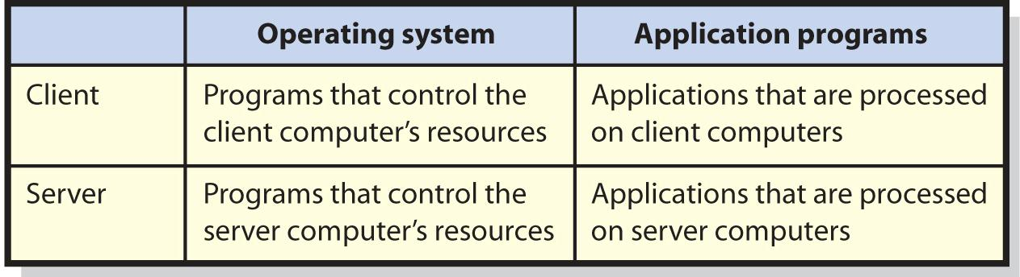
Basic categories of software

Slide 12
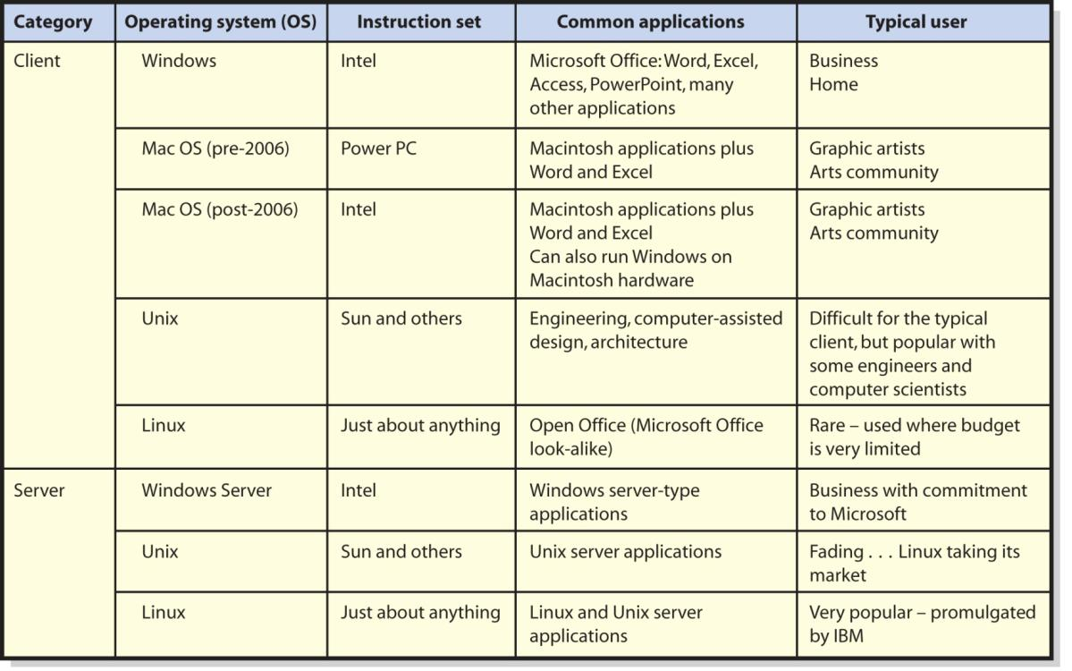
Four major operating systems

Slide 13
Own versus license
License
right to use a program, but not own it
Site licence
Flat fee to install software product on all company computers or all computers at a specific site.
Open Source
No license fee.
Notes:
You do not actually own a program—you own a license or right to use the program.
When you buy a Windows license, Microsoft is selling you the right to use Windows. Microsoft continues to own the Windows program.
Large organizations negotiate a site license that authorizes the company to install the product on all company computers or a specific site.
Linux, no company can sell you a license to use it. It is owned by the Open Source Community.

Slide 14
Virtualization
Virtualization: the process by which one computer hosts the appearance of many computers
One operating system, called the host operating system runs one or more operating systems as applications.
Those hosted operating systems are called virtual machines (vm)
Each VM has disk space and other resources allocated to it
Host operating system controls activities of virtual machines to prevent them from interfering with one another.
Three types of virtualization exist:
• PC virtualization • Server virtualization • Desktop virtualization

Slide 15
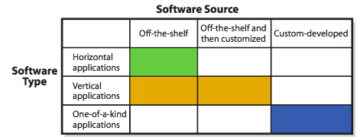
What Types of Applications Exist, and How Do Organizations Obtain Them?

Slide 16
categories of application programs
Horizontal-market application software
provides capabilities common across all organisations and industries
used in a wide variety of businesses, across all industries
purchased off-the-shelf, and little customisation of features is necessary (or possible).
Vertical-market application software
serves needs of a specific industry
usualy can be altered or customised
One-of-a-kind application software
developed for a specific, unique need.

Slide 17
Open Source Software
GNU (stands for ‘GNU Not Unix’)
GNU general public license (GPL) agreement
one of the standard license agreements for open source software
Successful open source projects:
OpenOffice (a Microsoft Office look-alike)
FireFox (a browser)
MySQL (a DBMS)
Apache (a web server)
Ubuntu (a Windows-like desktop operating system)
Android (a mobile-device operating system)

Slide 18
How Does Open Source Work?
Closed-source or proprietary software source code is not available to users or public. Only available to trusted employees and carefully vetted contractors.
Open-source software available to users in source code form.
Source code: Human readable computer code
Machine code: Source code is compiled into instructions executed directly by a computer’s CPU
Software
Notes:
Collaboration of many programmers.
Examining source code and identifying a need, creates new feature or redesigns existing feature, or fix a problem.
Code evaluated and extended by others.
Iteration, peer reviews and well-managed project yield high-quality code.

Slide 19
What Is the Purpose of a Database?
It keeps track of things.
A spreadsheets can do it also, but they still have disadvantages

Slide 20
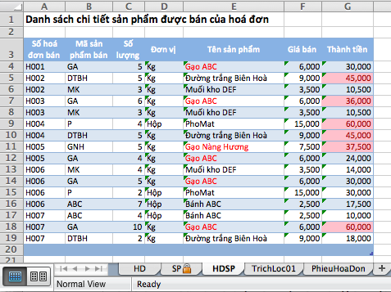
spreadsheets
Spreadsheets combine
Storage
Logic
Processing
Display

Slide 21
General Rule
Lists of data involving a single theme can be stored in a spreadsheet
lists that involve data with multiple themes require a database
the purpose of a database is to keep track of things that involve more than one theme.

Slide 22
What is a Database?
Database:
A self-describing collection of integrated records
In databases, bytes are grouped into columns, such as Student Number and Student Name. Columns are also called fields. Columns or fields, in turn, are grouped into rows, which are also called records.

Slide 23
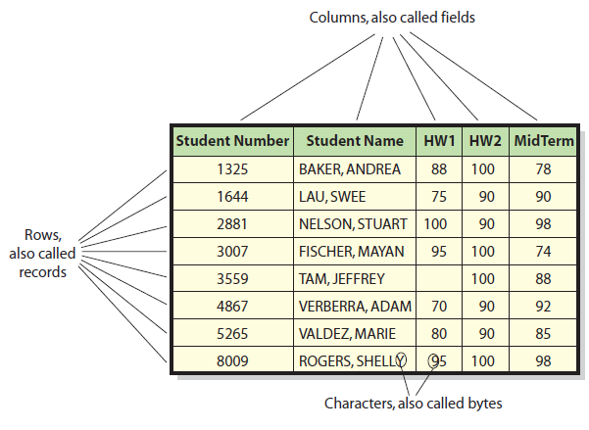
Characters, Fields, and Records

Slide 24
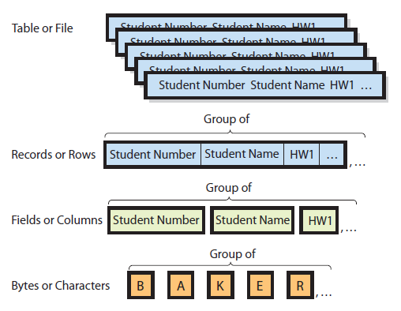
Hierarchy of Data Elements

Slide 25
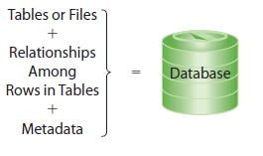
Structure of a Database
Source: textbook [1], pg 134
Metadata describes the structure of the Database, what values are allowed, who can access it, what can be deleted

Slide 26
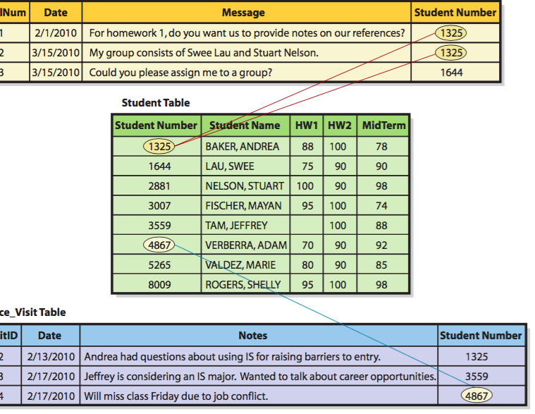
Relationships Among Rows

Slide 27
Relationship Special Terms
Key
A column or group of columns that identifies a unique row in a table.
Student Number is the key of the Student table.
Every table must have a key.
Sometimes more than one column is needed to form a unique identifier. In a table called City, for example, the key would consist of combination of columns (City, State).

Slide 28
Relationship Special Terms
Foreign keys
These are keys of a different (foreign) table than the table in which they reside.
Relational databases
Relationships among tables are created by using foreign keys.
Relation
Formal name for a table

Slide 29
What Is a Database Management System (DBMS)?
Program used to create, process, and administer a database.
Licensed from vendors such as IBM (DB2), Microsoft (Access and SQL Server), Oracle (Oracle Database), and others.
MySQL - open source.

Slide 30
Processing the Database
Four DBMS operations
Read
Insert
Modify
Delete data
Notes:
These operations are requested in applications that call upon DBMS in different ways.

Slide 31
Administering the Database
Used to set up a security system involving user accounts, passwords, permissions, and limits for processing.
Permissions can be limited in very specific ways.
Backing up database data, adding structures to improve performance of database applications, removing unwanted data.
most organizations dedicate one or more employees to the role of database administration
Notes:
Third DBMS function is to provide tools to assist in the administration of the database.

Slide 32
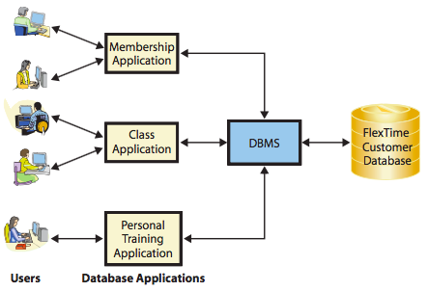
How do applications make databases more useful?

Slide 33
What do business professionals need to know about data communication?
What Is a Computer Network?
What Are the Components of a LAN?
What Are the Alternatives for Connecting to a WAN?
What Are the Fundamental Concepts You Should Know About the Internet?
What Processing Occurs on a Typical Web Server?
How Do Organizations Benefit from Virtual Private Networks (VPNs) and Firewalls?

Slide 34
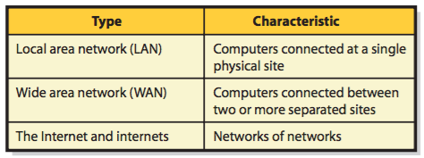
Computer Network
A computer network: collection of computers that communicate with one another over transmission lines or wirelessly.
Basic types:
Source: textbook [1], pg 170

Slide 35
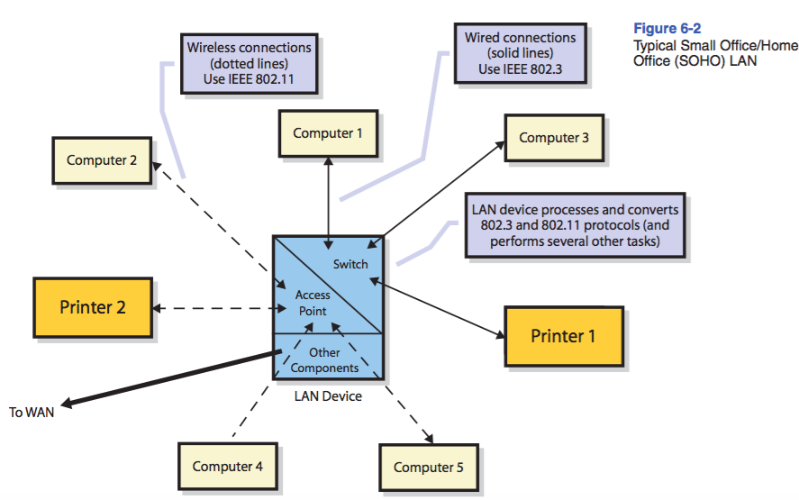
Components of a LAN?

Slide 36
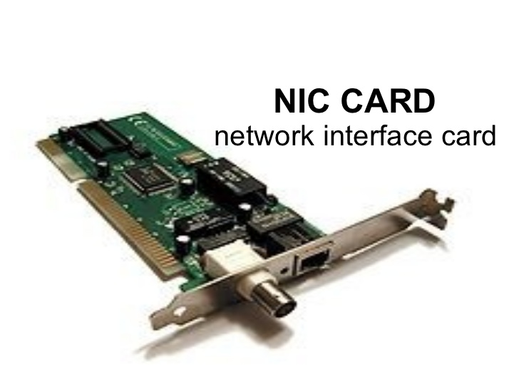
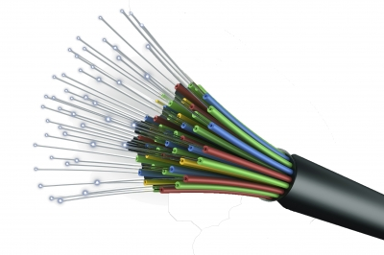
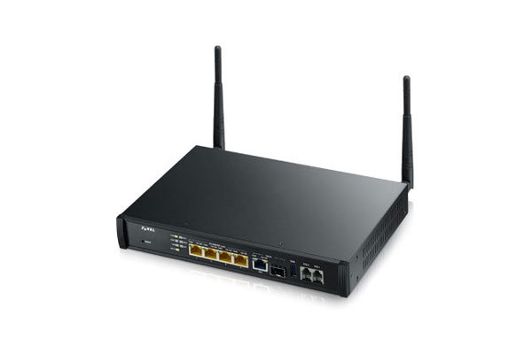
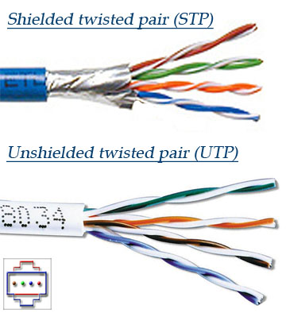
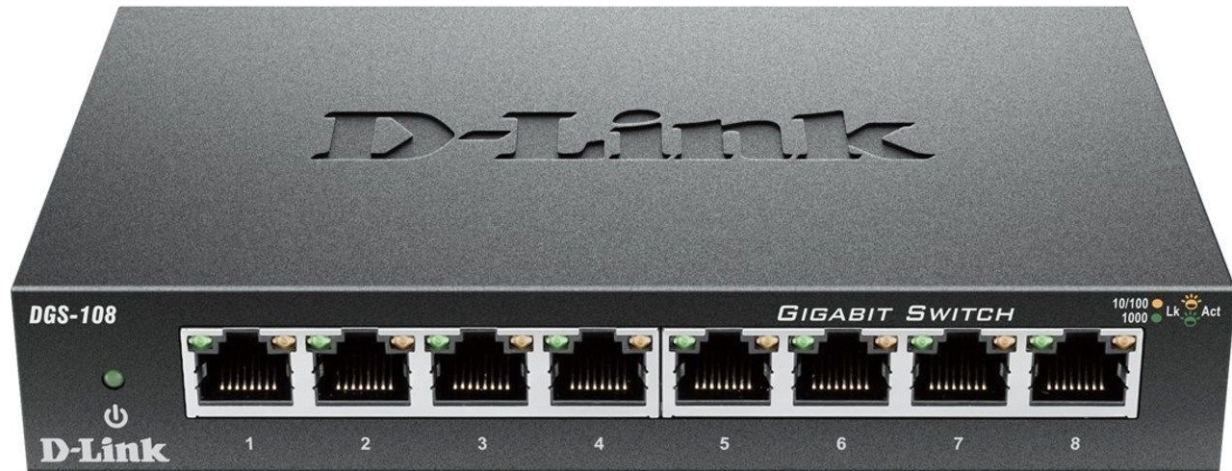
Wired Connectivity
optical fiber
Gateway
Cables
Switch
Notes:
Computers 1 and 3 and printer 1 are connected to a switch, which is a special-purpose computer that receives and transmits wired traffic on the LAN
Each wired computer or printer on the LAN has a network interface card (NIC), which is a device that connects the computer’s or printer’s circuitry to the network cables.
Most LAN connections are made using unshielded twisted pair (UTP) cable

Slide 37
Wireless Connections
The wireless computers and printer have a wireless NIC (WNIC) instead of a NIC
the WNIC devices connect to an access point
processes wireless traffic and communicates with the wired switch

Slide 38
LAN Protocols
Protocol is a set of rules that programs on two communicating devices follow
Wired LAN connections use the IEEE 802.3 protocol (Ethernet):
specifies hardware characteristics (e.g. which wire carries which signals)
describes how messages are to be packaged and processed
Wireless LAN connections use the IEEE 802.11 protocol
Bluetooth is another common wireless protocol

Slide 39
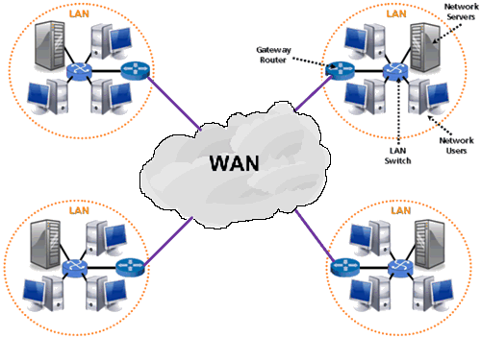
WAN
Source: www.diytechfactory.com

Slide 40
WAN
Sites obtain connection capabilities from another company licensed by the government to provide communications (Internet Service Provider – ISP)
ISP functions:
Provides a legitimate Internet address
serves as gateway to the Internet
pay for the Internet by collecting money from customers and paying access fees and other charges to telecoms

Slide 41
Alternatives for Connecting to a WAN
A DSL (digital subscriber line) line
cable TV line
a wireless-phone-like connection
How?
Modem (DSL modem, cable modems): converts digital data to analog signal
that analog signal is then sent over the telephone line, TV cable, or air

Slide 42
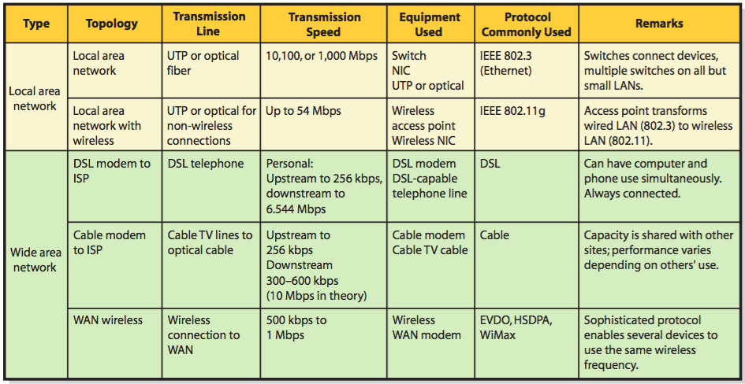
Summary of LAN and WAN Networks

Slide 43
What Are the Fundamental Concepts You Should Know About the Internet?
Internet: a network of networks
How does the Internet work?
The protocols used on the Internet are arranged according to TCP/IP Protocol (TCP/IP) architecture

Slide 44
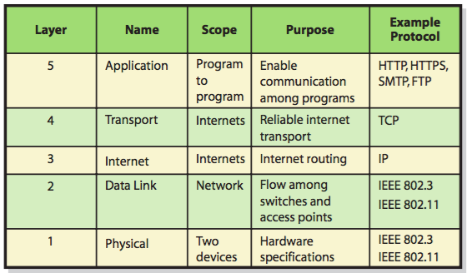
The TCP/IP Protocol Architecture
Note: Another model of TCP/IP Protocol Architecture: DARPA model (4 layers : Application, Transport, Internet, and Network Interface)

Slide 45
The TCP/IP Protocol Architecture
Application-Layer Protocols
Hypertext Transport Protocol (HTTP): used between browsers and Web servers
HTTPS: secure version of HTTP
SMTP (Simple Mail Transfer Protocol): used for email transmissions
FTP (File Transfer Protocol): used to move files over the Internet

Slide 46
The TCP/IP Protocol Architecture
TCP and IP Protocols
manage traffic as it passes across an internet from one network to another.
TCP (Transmission Control Protocol): provide reliable internet transport
IP (Internet Protocol): specifies the routing of the pieces of your message through the networks

Slide 47
IP Addressing
Public IP Addresses
Identifies particular device on public Internet.
Public IP addresses unique, worldwide.
Assignment controlled by ICANN (Internet Corporation for Assigned Names and Numbers).
Private IP Addresses
Identifies particular device on a private network.

Slide 48
IP Addressing
Major benefits
Public IP
Devices on LAN share a public IP address.
Private IP
Need not register computer with ICANN-approved agencies.
Assignment controlled within the LAN.
Notes:
Private/public IP address scheme two major benefits.
Public IP addresses conserved, is when all computers are on a LAN use only one public IP address.
Using private IP addresses, eliminates registering public IP address with ICANN-approved agencies.

Slide 49
Public IP Addresses and Domain Names
IPv4
Four decimal dotted notation like 165.193.123.253
Domain name
Worldwide-unique name affiliated with a public IP address.
Affiliation of domain names with IP addresses is dynamic.
Example: www.ueh.edu.vn
URL (Uniform Resource Locator)
Example: http://www.ueh.edu.vn
Notes:
Most common IP addresses format is IPv4.
ICANN administers system for assigning names to IP addresses. Domain name a worldwide-unique name affiliated with a public IP address. Affiliation of domain names with IP addresses is dynamic. Owner of domain name can change affiliated IP addresses at its discretion.
URL consists of a protocol (like http:// or ftp://) followed by a domain name or public IP address.

Slide 50
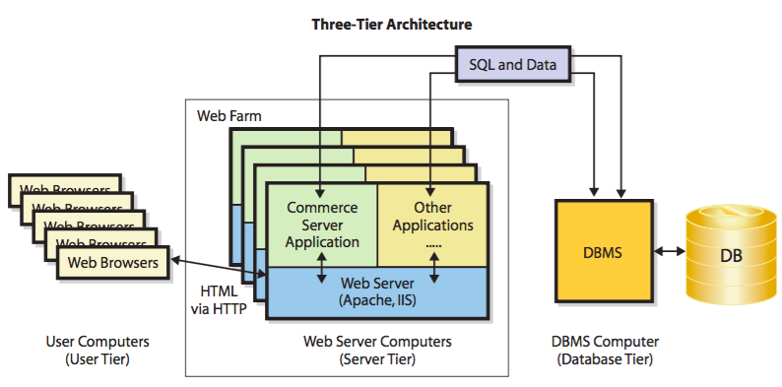
Processing Occurs on a Typical Web Server?
Three-Tier Architecture
Source: textbook [1], pg 179

Slide 51
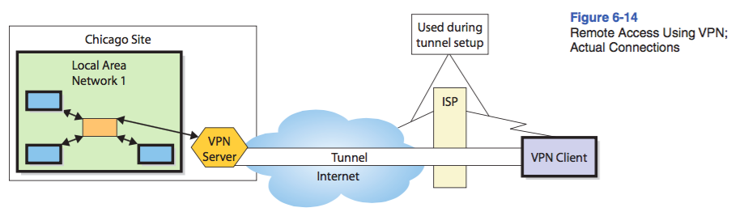
How Do Organizations Benefit from Virtual Private Networks (VPNs) and Firewalls?
Virtual Private Network
uses the Internet to create the appearance of of a private connection
A Typical VPN
Source: textbook [1], pg 189

Slide 52
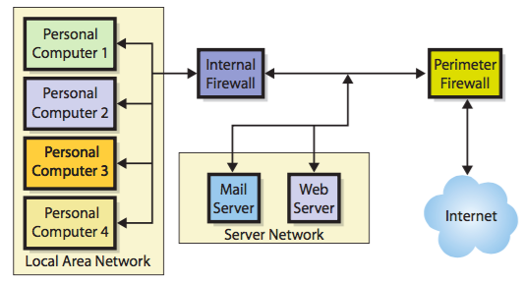
Firewalls
A firewall is a computing device that prevents unauthorized network access
Notes:
A perimeter firewall sits outside the organizational network; it is the first device that Internet traffic encounters
A packet-filtering firewall examines each part of a message and determines whether to let that part pass. To make this decision, it examines the source address, the destination address(es), and other data.
A firewall has an access control list (ACL), which encodes the rules stating which addresses are to be allowed and which are to be prohibited.

Slide 53
Q&A

